Slide 1
Library Management System

Slide 2
Introduction
Objective:
Develop a robust system for managing library operations efficiently.
Enhance the librarian's ability to handle member registrations, book issuances, and returns seamlessly.
Importance of Library Systems:
Provide organized access to a collection of books.
Facilitate tracking of borrowed books and member information.
Streamline library operations for both librarians and members.
Notes:
In today's digital age, a robust library system is more than just shelves of books. It's about creating an efficient environment for librarians and members alike. Our goal is to enhance how libraries operate, from streamlining member registrations to tracking borrowed books, ensuring that knowledge is both organized and accessible.

Slide 3
Project Overview
Scope:
Design and implement a Library Management System.
Facilitate librarian tasks such as member management, book transactions, and fine calculation.
Key Features:
Member Management: Add, display, and track details of library members.
Book Transactions: Issue and return books with due date enforcement.
Fine Calculation: Automatically calculate fines for overdue books.
Data Source: Utilize a CSV file for efficient data handling.
Technology Stack:
C++ Programming Language
Standard Template Library (STL) for efficient data structures
Git for version control
Catch2 for unit testing
Notes:
We're building a Library Management System to simplify library workflows, including membership management, book transactions, and fine calculations. Our technology stack leverages C++ with STL and Git for version control, ensuring a streamlined, efficient user experience. Data is smartly managed through CSV integration, optimizing our library's operational capabilities

Slide 4
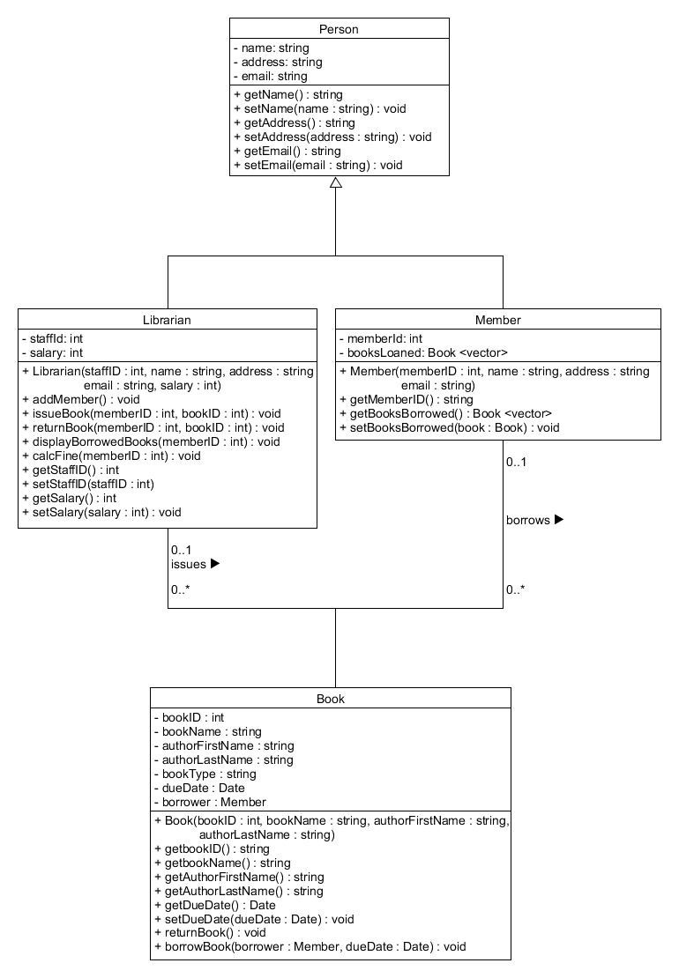
UML Diagram
Notes:
Our UML diagram outlines the structural design of our Library Management System, defining the interrelations of entities—books, members, and loans. This blueprint lays the groundwork for a system that is as logical in its operation as it is intuitive in its use, ensuring a seamless library experience.

Slide 5
Class Details
1. Book Class:
Attributes:
bookId: Unique identifier for each book.
title: Title of the book.
author: Author of the book.
dueDate: Due date for returning the book.
Functions:
displayDetails(): Display book details.
2. Member Class:
Attributes:
memberId: Unique identifier for each member.
name: Name of the member.
borrowedBooks: List of books borrowed by the member.
Functions:
displayDetails(): Display member details.
hasOverdueBooks(): Check if a member has overdue books.
calculateFine(): Calculate fine for overdue books.
3. Library Class:
Attributes:
availableBooks: List of books available in the library.
members: List of library members.
Functions:
addMember(): Add a new member to the library.
issueBookToMember(): Issue a book to a library member.
returnBookFromMember(): Return a book from a library member.
findMemberById(): Find a member by ID.
findBookById(): Find a book by ID.
4. Date Class:
(If using <chrono> library)
Functions:
getCurrentDate(): Get the current system date.
calculateDueDate(): Calculate the due date for book return.
Notes:
Our system's architecture is detailed in four core classes: Book, Member, Library, and Date. Each serves a unique role, from managing book details to tracking member activities. Together, they create a cohesive library ecosystem, bolstered by functions ensuring smooth operations and excellent user interactions for our community.

Slide 6
System Functionalities
Add a Member:
Librarian can create a new member.
Display the new member's details immediately.
Issue a Book:
Librarian can issue a book to a member.
Set a valid due date (e.g., 3 days from the issue date).
Return a Book:
Librarian can process the return of a book from a member.
Display Borrowed Books:
Librarian can view all books borrowed by an individual member.
Calculate Fine:
Upon book return, if due date is exceeded, calculate a fine.
Fine rate: £1 per day overdue.
Book Class:
Represents book attributes (ID, title, author, due date).
Displays book details.
Notes:
Our library system's functionalities cater to modern needs: member addition, book issuing with due dates, returns processing, borrowed book displays, and fine calculations, all streamlined for efficiency. The Book class further simplifies access to book details, ensuring a user-friendly experience for both staff and members.

Slide 7
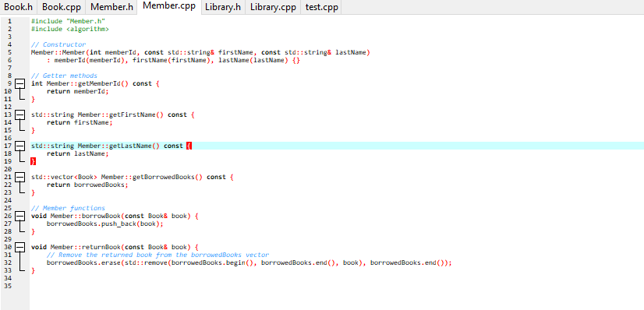
Code Snippets - Member Class
Notes:
Our Member Class is engineered with precision, enabling robust member registration and management. It provides essential functionalities like getting member details and managing book borrowals, ensuring a streamlined library experience. The class is a testament to our commitment to efficient and effective library management.

Slide 8
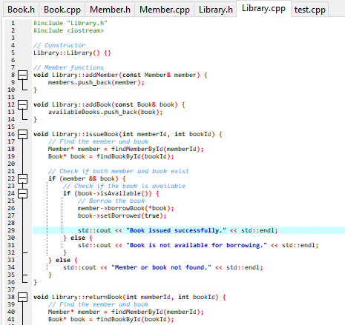
Code Snippets - Library Class
Notes:
The Library Class in our system is the cornerstone of operations, facilitating book additions and member-book interactions. It ensures books are issued and returned efficiently, with checks for availability and ownership. This class is pivotal for maintaining the seamless circulation of our library's valuable resources.

Slide 9
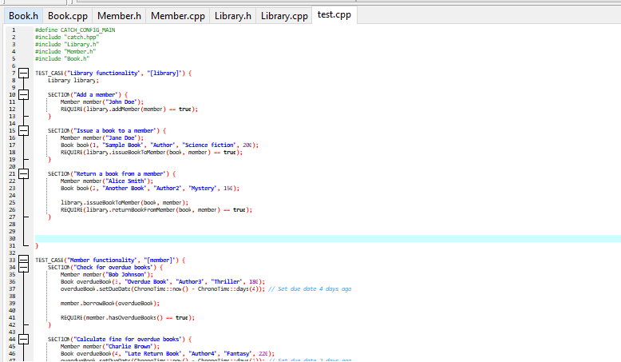
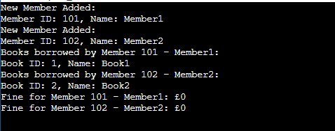
Testing
Notes:
Our testing protocol rigorously evaluates each library system function, ensuring reliability. We simulate real-world operations, from registering members to book transactions, confirming the system's readiness for deployment. This thorough testing underscores our commitment to providing a dependable and user-friendly library management experience.

Slide 10
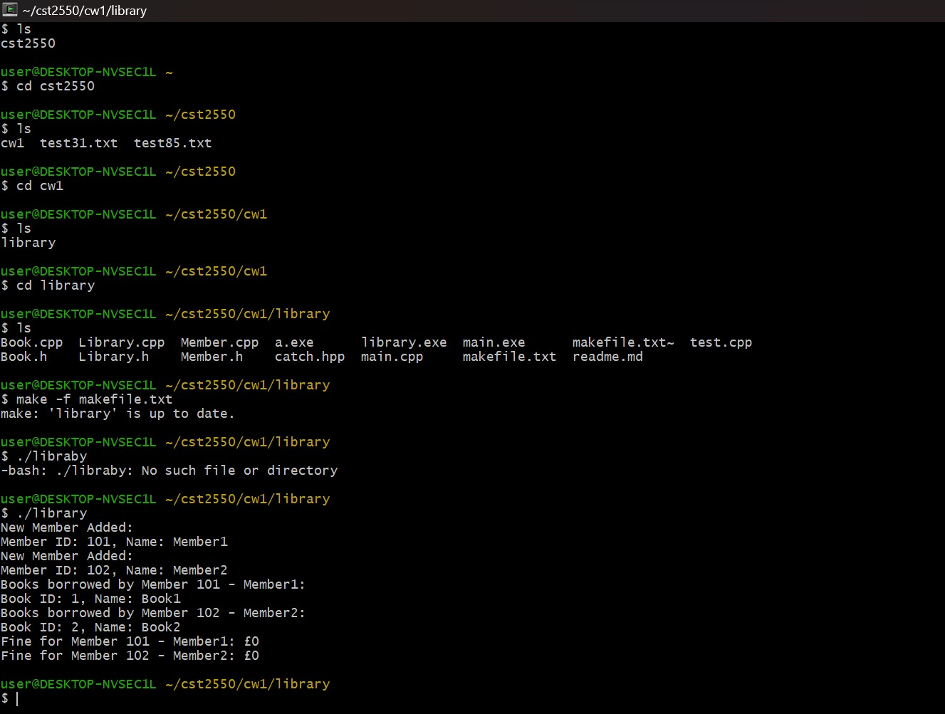
Code execution:
Notes:
From the screenshot it can be seen that the code has been executed successfully.

Slide 11
Summary
Project Overview:
Developed a Library Management System in C++.
Facilitates efficient library operations.
Class Details:
Book Class: Represents book attributes.
Member Class: Manages member details and book transactions.
Library Class: Orchestrates overall system operations.
System Functionalities:
Add members, issue and return books.
Display borrowed books and calculate fines.
Error Handling:
Robust error handling for invalid inputs or actions.
Testing:
Comprehensive testing ensures system reliability.
Notes:
We've crafted a Library Management System in C++ to enhance library operations. Our design details classes like Book and Member for transactions and attributes. The system boasts robust functionalities for member management and error handling, ensuring seamless service. Rigorous testing guarantees its reliability, readying it for a superior library experience.

Slide 12
Thank You

